Slide 1
Investor Behaviour:
A Few Simple Truths
Prepared for:
2012 MFDA All Staff Annual Training
Prepared by:
Edwin L. Weinstein, Ph.D., C. Psych.
President, The Brondesbury Group
16 February 2012

Slide 2
Topics for Today
What do investors want to know
  How do professionals think – How do investors think
How knowledgeable are investors about investing
  General knowledge
  Risk/reward
How do investors make their decisions
  Seeking information
  Trusting the advisor
Suitability of investments
Concluding remarks

Slide 3
What Investors Want to Know
Canadian investors want to know just enough
To make a decision they must make
Due to a life event and
Be comfortable with their choice.
… This is less than you think they should know!

Slide 4
What are they thinking?
risk
reward
asset mix
product
goals
suitability
trust
how much?
family
pay debt ?
what’s that?
spend – invest
lifestyle
safety

Slide 5
As Investors See It
“It seems to be too overwhelming. Too many companies and too much information to be able to make a good decision and because my time is very limited, I have not yet had enough time to dedicate to getting this done” (Online Focus Group Age 20 – 34, Investor Education Fund, July 2010.)
“It is an education decision and you try to research whatever you are looking for and then the timeframe comes to an end, you have to make a decision and then you base your decision on what you have read so far. (Focus Group Age 35+, Retired Group, Investor Education Fund, Sept 2010)
“So you’re looking at one (account reporting statement) and well what does this mean? What does that mean? It would be really nice if you looked at the same thing and it would be in the same column so you could compare apples to apples.” (Focus Groups, Account Reporting Practices, Ontario Securities Commission, Sept 2011)
“I should have a level of savvy. I have my MBA. I have taken financial courses. It just doesn’t turn my crank. I just shut down when I get into it.” (Focus Group 35+, Preparing for Retirement Group, Investor Education Fund, Sept 2010)
“We learned that it is harder than I thought to make a decision on which company to go with when starting an RESP. We still have not decided because we have not figured out (not enough time yet) to decide which company is best.” (Online Focus Group Age 20 – 34, Investor Education Fund, July 2010.)

Slide 6
How Knowledgeable are Investors?
Material courtesy of the Investor Education Fund and
the Ontario Securities Commission

Slide 7
What Can People Learn?
Literacy Level
5
4
3
2
1
% Population*
16%
(4/5)
34%
31%
20%
Integrated Learning
Decisions & Implications
Learn How to Make the Best Decisions
Follow steps for Safe Decisions
Simple Facts -- Avoid Pitfalls
* Source: Adult Literacy and Life Skills, 2005..

Slide 8
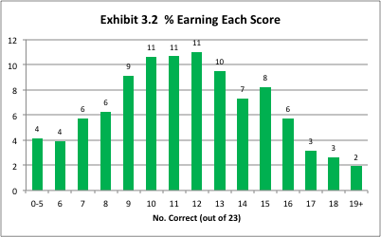
Only 6 out of 10 get Half Right
Results of an Investor Knowledge Survey
Investor Education Fund, November 2010

Slide 9
Sample Knowledge Questions
If you know you will need all of your savings to pay for expenses two years from now, stocks are a safe place to park your money until you need it (73%)
Over the next 20 years, the stock market will probably earn more money than a savings account (64%)
Generally speaking, a stock (equity) mutual fund is less risky than buying one or two stocks yourself (59%)
An investment pays 5% annual interest. If you put in $1000 today, how much money will you have two years from now (39%)
Inflation is 2%... In five years you will earn 5% more than you do now. Will your standard of living in five years be… (21%)

Slide 10
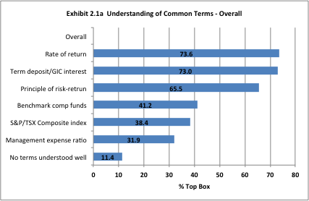
Do Investors Understand Common Terms?

Slide 11
Do Investors Understand Common Cost Terms?

Slide 12
Risk-Return: Theory & Practice
When asked how well they understood the principle of “risk-return”, some 4 out of 6 of investors said they understood it well or very well.
When given an example that required the application of the principle (without it being named), 1 out of 6 successfully applied it.

Slide 13
How Investors Make their Decisions:
Age Makes a Difference
Material courtesy of the Investor Education Fund and
the Ontario Securities Commission

Slide 14
Getting Information to Decide

Slide 15
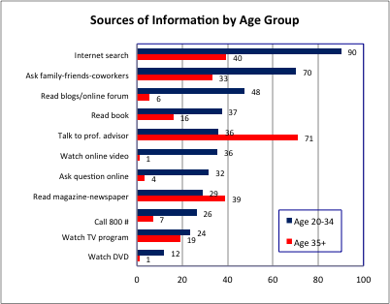
Sources Change with Age

Slide 16
Simplified Conclusions
Under-35’s are skeptics. They are more peer-oriented seeking out the views of like-minded people both online and off. They trust the motives of peers over advisors. They compare a wider range of sources and infer ‘the truth’ by finding the common ground. They don’t stop until they find the common ground.
Over-35 trust experts. They talk to advisors and read articles by experts in newspapers, magazines and books. Even though everyone we interviewed uses the internet, it is not a primary vehicle for information-seeking. Once they find “an answer” they can live with, they generally stop looking for information.
Blind trust in an advisor makes groups more vulnerable to scams

Slide 17
Decision Criteria
The single biggest decision factor is what the advisor recommends but within that…
Performance and portfolio mix dominate decisions
  Relative to similar investments
  Relative to alternative types of investment
  Relative to past earnings
Risk of loss is a major factor ONLY for deciding “NO”
Advisors typically discuss all these
  Most give several choices
  They give the reasons for their recommendations

Slide 18
People say they consider…

Slide 19
Suitability of Investments
  Real knowledge
  Real risks
  What is really suitable?

Slide 20
Real Knowledge:
Comments from Advisors
Less Sophisticated (Bottom quartile)
  “They think you can get a total guarantee from the advisor for the money they invest. You have to explain risk and return and that nothing is guaranteed.”
  “They don’t understand the amount of risk that needs to be endured to get a high return.
  “Less sophisticated ask general questions. What should I invest in? What is a mutual fund? How does the stock market work?”
  “Very little awareness of risk, interest or inflationary issues.”
More Sophisticated (Top quartile)
  “Ask more in-depth questions, wanting solutions to more complicated problems.”
  “Have better historical sense and know there will be ups and downs in the market.”
  “They think they know a lot more than they do.”
Source: “An Advisor View of Consumer Questions”, Investor Education Fund, 2003.

Slide 21
Real Risks (Based on unpublished research w/opinion leaders)
Risk is ‘framed’ in terms of investment volatility.
Current measures of risk fail to consider….
  Life event risks like job loss, disability, maternity leave, family illness, longevity risk and more
  Environmental risks that affect individual judgments of risk, such as news events, stock market trends, the economy, USD exchange and other factors
  Comprehensive risk profile including insurance, banking, use of different accounts for different purposes, etc.
  Lifestyle preferences (especially for retirement)
  Real product understanding

Slide 22
What is Really Suitable?
A mix of financial products that are suitable based on
  Existing portfolio and asset mix
  Financial goals and Lifestyle goals
  Investment risk profile
  Real life risks
  Investor understanding
  A holistic view of the investor
Where advisor disclosure includes:
  Specific criteria/reasons for choice including amount
  Potential risk and returns
  All transaction and service costs
  A discussion of alternative investments and asset classes

Slide 23
Concluding Remarks
Knowledge levels are lower than believed
  Numeracy & literacy are limiters, especially over age 65
  People over-state their knowledge
  Knowledge levels far outstrip ability to apply
Information-seeking/Decisions differ by age
  Under-35 skeptics and information seekers
  Over-35 trust experts and rely on them
  Say they decide on likely gain/loss – but do they?
Suitability is based on a simplistic notion of risk
  Real investor risk is more complex than captured now
  No good models for assessing real risk yet

Slide 24
For Further Information
For report overviews, go to:
http://www.getsmarteraboutmoney.ca/Investor-research/Our-research/Documents/A-study-on-what-Canadian-Investors-age-20-34-want-to-know-about-personal-finance.pdf
http://www.getsmarteraboutmoney.ca/Investor-research/Our-research/Documents/A-study-on-what-Canadian-Investors-age-35-and-over-want-to-know-about-personal-finance.pdf
http://www.getsmarteraboutmoney.ca/Investor-research/Our-research/Documents/A-comparitive-study-on-what-Canadian-Investors-age-20-34-and-35-and-over-want-to-know-about-personal-finance.pdf
http://www.getsmarteraboutmoney.ca/research/Our-research/Documents/Rpt_InvKnowl_Abridged_final%202011.pdf
http://www.osc.gov.on.ca/documents/en/Securities-Category3/rpt_20110622_31-103_perfomance-rpt-cost-disclosure.pdf
http://www.osc.gov.on.ca/static/_/Dialogue2011/dwo_20111101_ss-bo2-investor-issues-high.mp3
Soon to be published at http://www.getsmarteraboutmoney.ca/research/Our-research/Pages/default.aspx
Advisor relationships and Investor Decision-Making

Slide 25
THANK YOU
The Brondesbury Group
www.brondesbury.com

